Slide 1
SECURE DATA HIDING IN IMAGES USING STEGNOGRAPHY
CAPSTONE PROJECT
Presented By: Patel Ritesh
Student Name : Patel Ritesh Dhirubhai
College Name & Department : R.N.G Patel Institute Of Technology

Slide 2
OUTLINE
Problem Statement
Technology used
Wow factor
End users
Result
Conclusion
Git-hub Link
Future scope

Slide 3
Problem Statement
In the traditional encryption methods, the text can be easily detected, This project intends to hide secret messages in the pixels of an image, thereby providing a secure steganographic method of encryption and decryption.

Slide 4
Technology used
Python used for programming language on vs code as a platform for programming.
Libraries and Modules:
OpenCV (cv2) - Handles image reading, pixel manipulation, and saving encrypted images
OS - Used to interact with the operating system for opening the encrypted image.
String Module: Used in encryption for character-to-ASCII mapping.
Encryption Methodology:
For encryption, converting characters to ASCII values, embedding into image pixel values.
For decryption, it uses a simple password-based authentication.
Decryption Approach:
Extracts the ASCII values from the pixel data and reconstructs the message.
Decrypted texts require the correct password to decode the hidden texts.

Slide 5
Wow factors
U can hide your meassage within the image .
U can add password to the your meassge so that receiver decrypt your meassge if receiver has the password.
It will works on multiple platform of operating system.
It use minimal computatoional resources.
It is easy to operate and not having loading issues.

Slide 6
End users
Students
Researchers
Journalists
Forensic
Law Enforcement Agencies
General Users

Slide 7
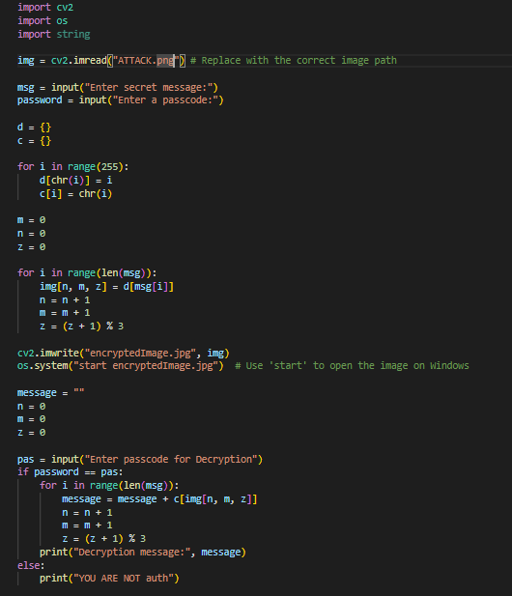
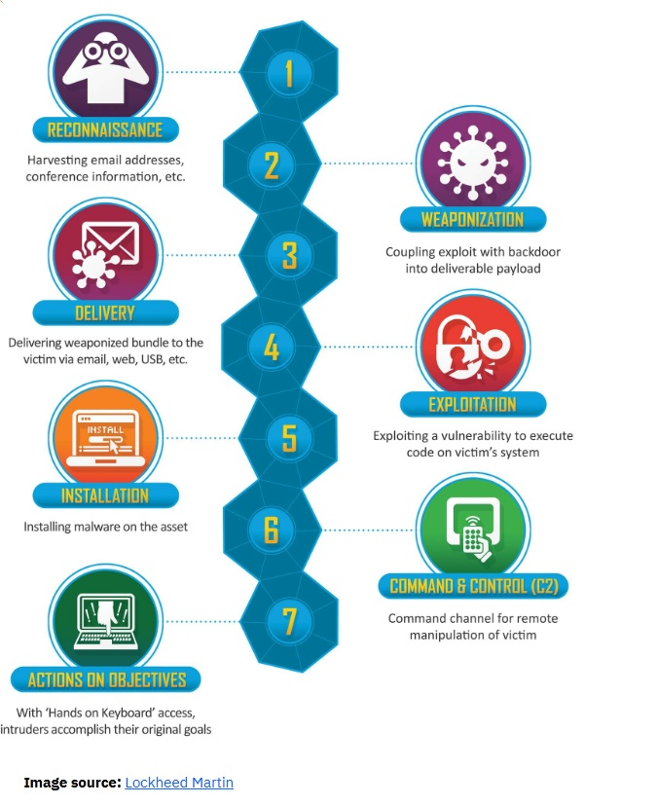
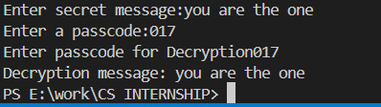
Results
Sourcec Code Encrypted image Decryption

Slide 8
Conclusion
It secures messages inside images through steganography. This is done by embedding the text in the pixel values while it is decrypted through a password. Hence, the transfer of messages is kept private. The approach is very efficient as well as easy to use and very hard to detect. Thus, it is a promising and very good method for secure data transmission in the future, using which one can further enhance security and usability.

Slide 9
GitHub Link
Github Link : https://github.com/Rits0p/AICTE-PROJECT

Slide 10
Future scope(optional)
Software development has focused on improving security using advanced encryption algorithms.
The graphics user interface reportedly was implemented for easy interaction with the system by the user.
Supports several file formats for encoding.

Slide 11
THANK YOU

